Slide 1

Computerized Cash Advance System
By: Clement Beauvais
Financial Web Application

Slide 2
Project Motivation

Slide 3
Project objective
Setting up my environment

Slide 4
Technologies used
This web application will be able to run on any web browser. Here are the technologies used:
Eclipse Indigo with JDK 1.6
Apache Tomcat web server
MySQL Server 5.6 database
J2EE
Spring MVC
Hibernate (Object-relational mapping API for data persistence)

Slide 5
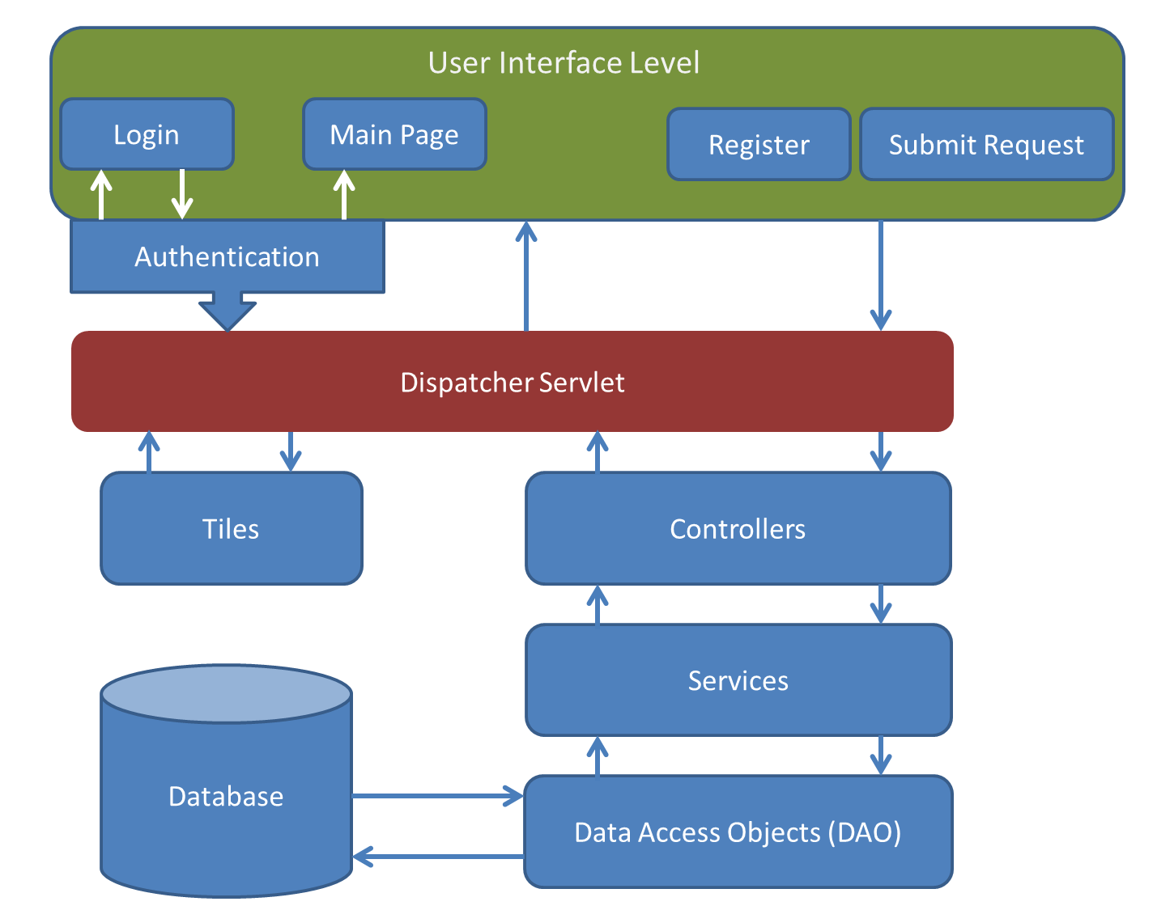
SYSTEM ARCHITECTURE

